Slide 1



Hackathon 2024: 404NotFound

Slide 2






2
Team 404NotFound Members
Team Lead - Amal Gopi
4th Year
Technical Interests - Data Science
projects worked:
1. virtual mouse and keyword
2. AI interview system
Documentation - Jeeva C S
3rd Year
Technical Interests - Machine Learning
projects worked:
Authenticated vehicle access using ANPR
Software Engineer - Deepak Nair V P
4th Year
Technical Interests – Machine Learning
Projects worked:
1. College Event Management System
2. AI Powered Resume Parser
Presentation - Elvin Jimmy
4th Year
Technical Interests - Data Analyst
projects worked:
1.Parking space detection using Python
2. Automatic HTML Code Generation Using Machine Learning Techniques
ML Engineer - Harankumar M S
4th Year
Technical Interests – Blockchain
Projects worked:
EV Station finder Android App
Image/ Video Colorization Using CNN

Slide 3

3
LLM Problem Statement: Why
Develop an automated system to analyze online customer reviews, classify sentiments, identify issues in negative reviews, propose solutions. The goal is to enhance seller understanding of feedback, improve product quality, and boost customer satisfaction.

Slide 4
4
LLM Business Problem: What
Operational Challenges: SMEs encounter difficulties in planning for the future, managing complexity, and increasing sales/profit margins.
Limited Resources: SMEs operate with constrained budgets and lack of technical expertise, hindering their ability to adopt complex solutions.
Assistance: There is a demand for user-friendly and accessible solutions to help SMEs overcome challenges and improve operations effectively.

Slide 5
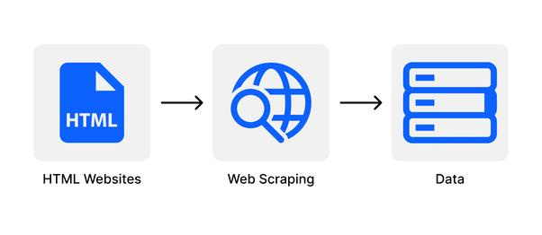
5
Solution Overview: How
WEB SCRAPING
Define the URL for the Amazon product page and set optional HTTP headers for browser-like interaction.
Send an HTTP GET request and parse the HTML content with BeautifulSoup.
Iterate over a predefined number of pages, fetching each review page. Systematically extract review text and dates from each review element.

Slide 6
5
Solution Overview: How
SENTIMENT ANALYSIS
Prepare text data by removing HTML tags, punctuation, and stopwords, and then lemmatize for normalization.
Assign sentiment scores (-1 to +1) using the VADER lexicon for each review.
Categorize reviews as Positive, Negative, or Neutral based on sentiment score thresholds.
Implemented the VADER lexicon, a rule-based sentiment analysis tool, to evaluate the sentiment of text data.

Slide 7
5
Solution Overview: How
PRODUCT NAME , CATEGORY AND PROBLEM IDENTIFICATION
Leveraging web scraping techniques, the code extracts the product name from the Amazon product page HTML using BeautifulSoup.
Utilizes predefined keyword sets to classify the product into relevant categories based on its name.
Implements a dictionary associating common product problems with keywords.
Scans the cleaned review text for occurrences of these keywords to identify and record product issues effectively.

Slide 8
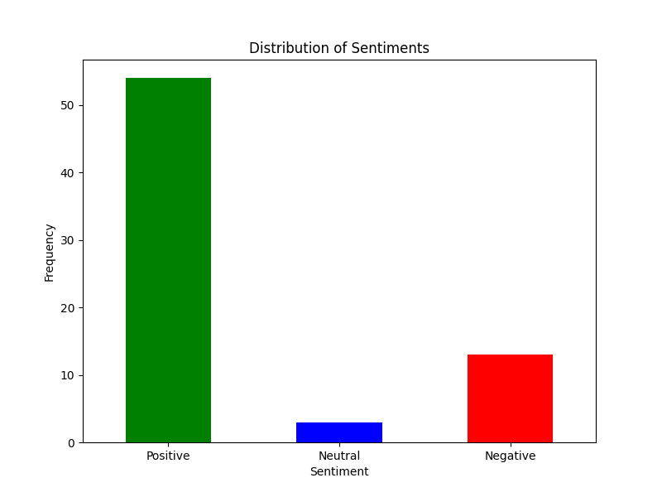
5
Solution Overview: How
REVIEW COUNT CHART
Utilizes Matplotlib to showcase sentiment category frequencies.
Employs Pandas for computing and reordering sentiment counts.

Slide 9
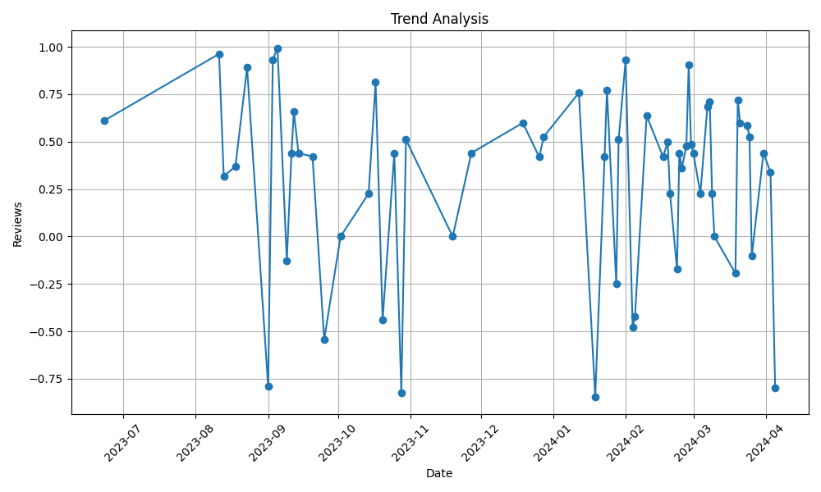
5
Solution Overview: How
TREND ANALYSIS CHART
Employs Pandas for grouping by date and computing average sentiment.
Utilizes Matplotlib to generate line plots illustrating sentiment trends.

Slide 10

5
Solution Overview: How
SOLUTION FOR IDENTIFIED PROBLEMS
Utilized LangChain, an innovative framework for leveraging language models in application development.
LangChain's integration with Large Language Models (LLMs) like OpenAI for text generation.
LangChain's Prompt Template class is a used for dynamic prompt generation.

Slide 11

6
Economic Logic
AI-driven automation minimizes manual tasks, reducing labor costs for analysis and problem-solving.
Swiftly addressing customer issues enhances satisfaction, retention, and revenue while lowering acquisition costs.
Customer feedback directs product enhancements, marketing strategies, and resource allocation for optimized operations.

Slide 12
6
Flowchart
Web scraping
Dataset
Preprocessed data
sentiment analysis
product name
problem identification
review count chart
trend analysis chart
langchain
solution

Slide 13
6
Challenges Faced
Implementing an efficient web scrapping method.
Selecting an efficient LLM model.
Integrating backend and frontend.

Slide 14
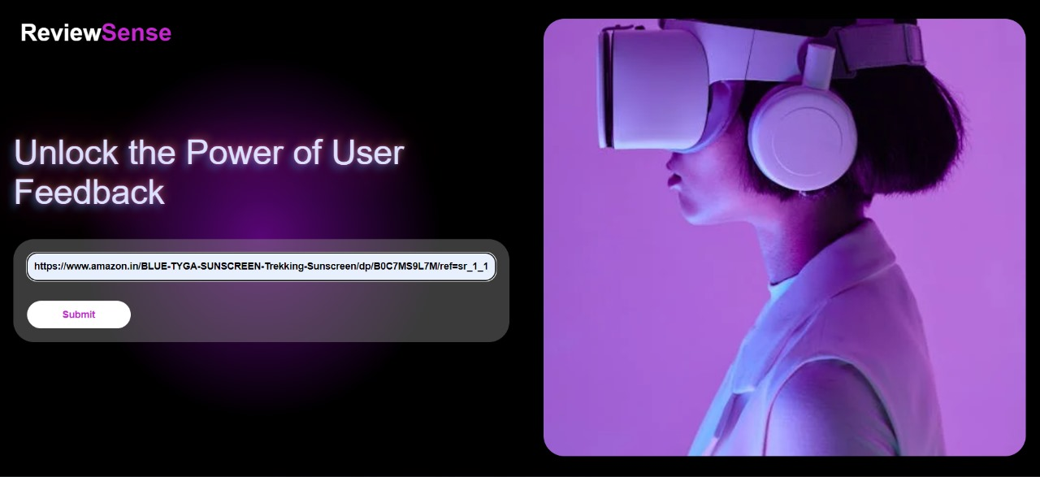
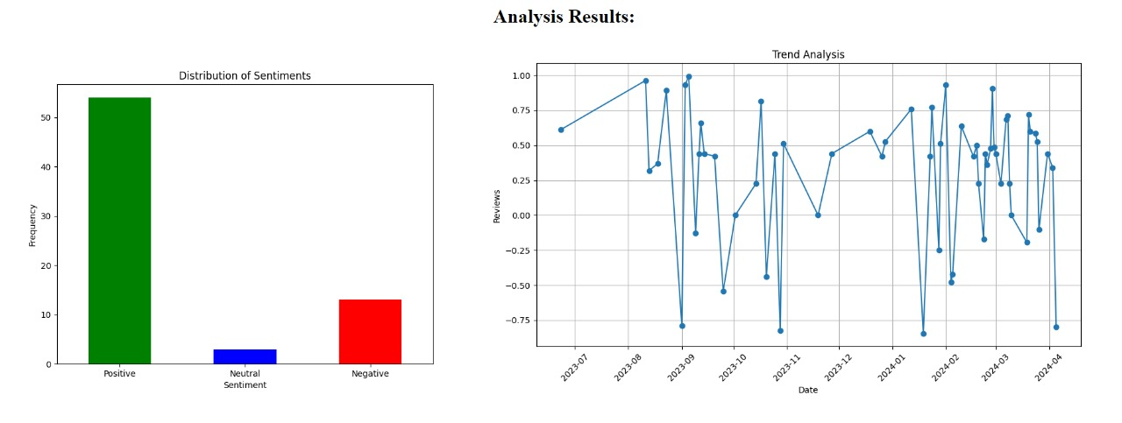
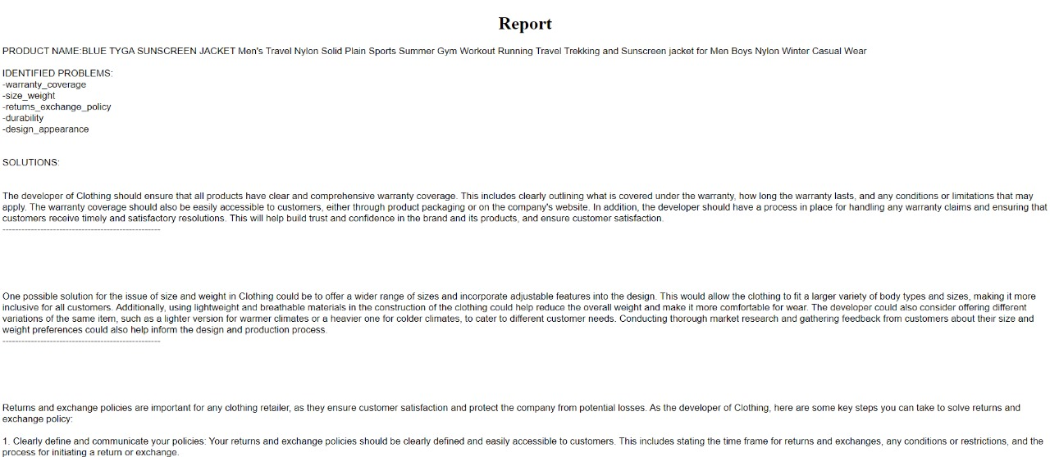
7
Project Demo

Slide 15
THANK YOU
THANK YOU

